Slide 1


Slide 2


Covid-19 Data Analysis from
Nishtha Singh
1703013047

Slide 3
Objective
To analyze and see if there is any relationship between the spread of the virus in a country and how developed country is.

Slide 4
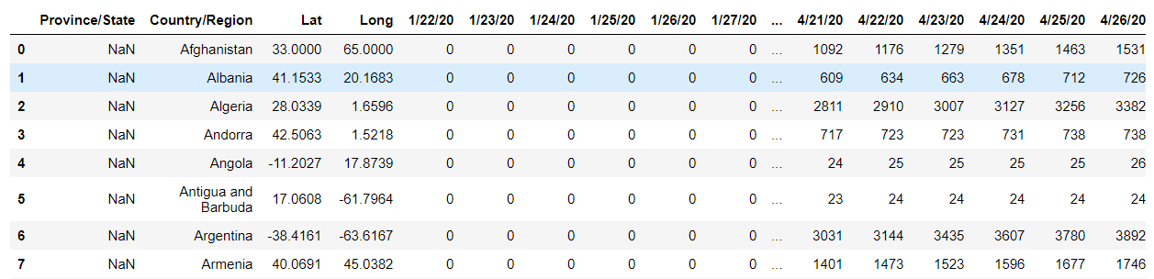
Datasets used
COVID19 Dataset- Published by John Hopkins University, which consist of the data related to cumulative number of confirmed cases, per day, in each Country.
Happiness Dataset-Published by World Happiness Report,which consist of various life factors, scored by the people living in each country around the globe.

Slide 5
Technology Used
Python Basics
Python Data Structures-Lists
Python Libraries-Numpy ,Seaborn,Pandas,Matplotlib
Jupyter Notebook

Slide 6
Libraries Used
Numpy
Numpy Python library is used for including any type of mathematical operation in the code. It is the fundamental package for scientific calculation in Python. It also supports to add large, multidimensional arrays and matrices.
Matplotlib
It is a Python 2D plotting library, and with this library we can plot any type of charts in Python for the code

Slide 7
Libraries Used(contd.)
Pandas
It is an open-source data manipulation and analysis library.
Seaborn
Seaborn is a library that uses Matplotlib underneath to plot graphs. It will be used to visualize random distribution

Slide 8
Methodology
Importing COVID19 dataset
Imported COVID19 dataset and prepared it for the analysis by dropping columns such as longitude and latitude and aggregating rows having same country but different states from the dataset .
Finding a good Measure for analysis
Calculated a good measure for our analysis i.e maximum infection rate.
Importing World happiness report dataset
Import World happiness report dataset, dropping useless columns such as overall rank,score and corruptions and Merge it with COVID19 dataset to find correlations among our data.
Visualizing the results
Visualized the results using Seaborn library by plotting different graphs.

Slide 9
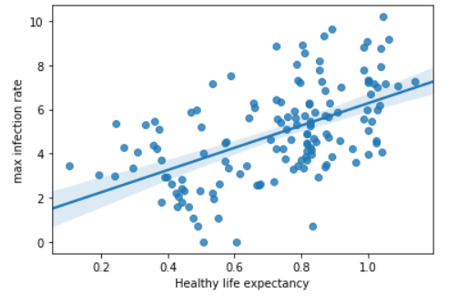
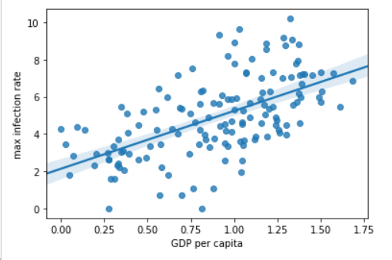
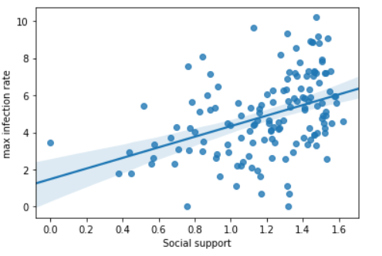
Visualization
Positive correlation among various factors can be seen :

Slide 10
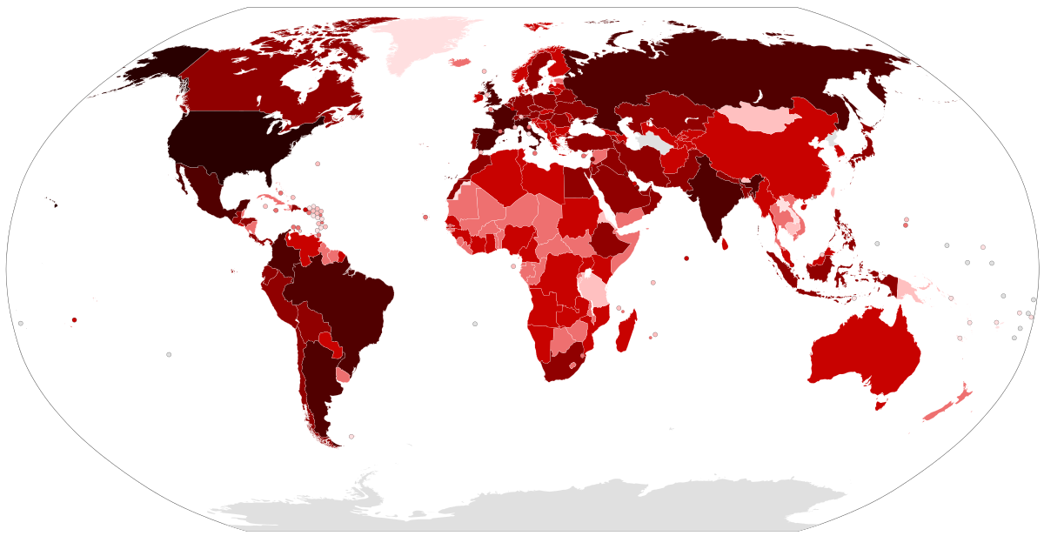
Result/Conclusion
Number of Confirmed Covid-19 cases are more in More Developed Countries as compared to less Developed.
The reason can be due to low availability of testing kits or maybe expensive test conduction.
This Photo by Unknown Author is licensed under CC BY-SA

Slide 11
References
[1] John Hopkins University (2020), consist of the data related to cumulative number of confirmed cases, per day, in each Country, Vol. 1.
[2] World Happiness Report (2018), consist of various life factors, scored by the people living in each country around the globe.
[3] Ramjeet Singh Yadav (2020), Data analysis of COVID-2019 epidemic using machine learning methods
[4] Stoecklin SB, Patrick R, Yassoungo S, Alexandra M, Christine C, Anne S, Matthieu M et al (2020), First cases of coronavirus disease 2019 in France: surveillance, investigations and control measures. Eurosurveillance 25:6

Slide 12
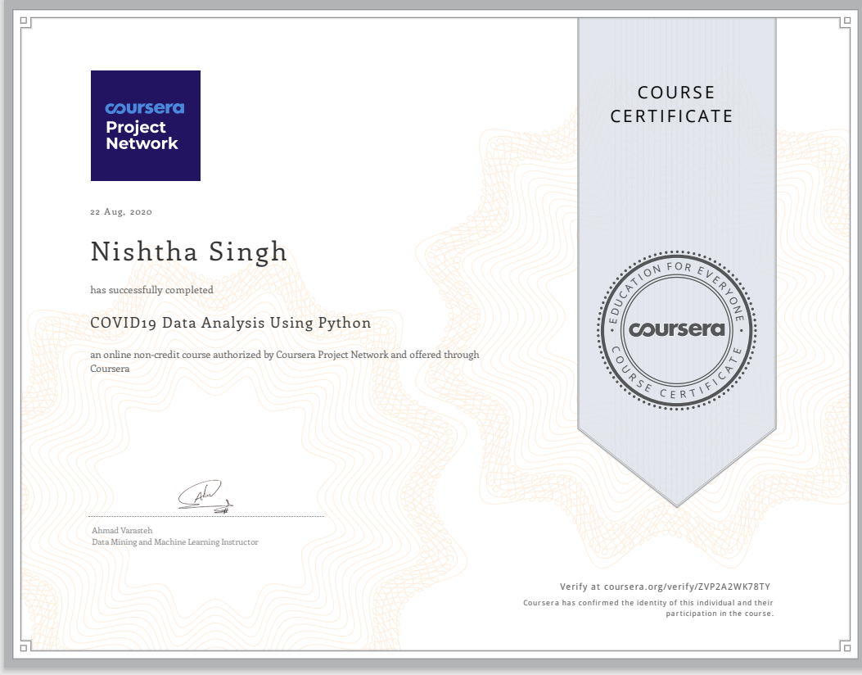

Slide 13
Thank You

